Slide 1
Data visualization
The representation of information in the form of a chart, graph, diagram, picture, etc.
"data visualization can also be used as a reporting tool“
Data visualization is the graphical representation of datasets and information. Data visualization is an umbrella term for visualizing all types of data through charts, graphs, and maps.
The ultimate goal is to visually represent your data in an accessible and easy-to-understand manner.
Visualizing data is a fundamental step in understanding trends, uncovering patterns, and tracking outliers.
Data visualization provides a good, organized pictorial representation of the data which makes it easier to understand, observe, analyze.

Slide 2
What are the Different Types of Data Visualization?
Bar graphs
Line graphs
Pie charts
Scatter plots: A slightly more advanced data visualization method is scatter plotting. Scatter plots are an effective way to explore the relationship between two variables and multiple sets of data.
Histogram

Slide 3
Python provides various libraries that come with different features for visualizing data. All these libraries come with different features and can support various types of graphs.
The four libraries are:
Matplotlib
Seaborn
Bokeh
Plotly

Slide 4
import pandas as pd
# reading the database
data = pd.read_csv("tips.csv")
# printing the top 10 rows
print(data.head(10))
Tips database is the record of the tip given by the customers in a restaurant for two and a half months in the early 1990s. It contains 6 columns such as total_bill, tip, sex, smoker, day, time, size.

Slide 5
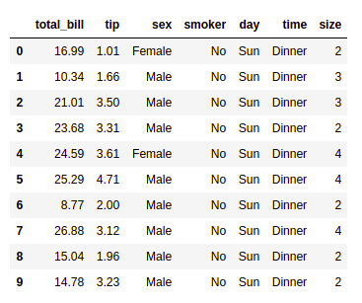
Matplotlib
Matplotlib is an easy-to-use, low-level data visualization library that is built on NumPy arrays. It consists of various plots like scatter plot, line plot, histogram, etc. Matplotlib provides a lot of flexibility.
Pip install matplotlib

Slide 6
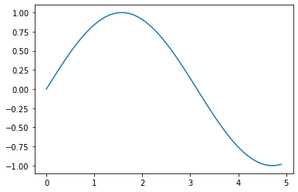
Scatter Plot
Scatter plots are used to observe relationships between variables and uses dots to represent the relationship between them. The scatter() method in the matplotlib library is used to draw a scatter plot.
matplotlib.pyplot
is a state-based interface to matplotlib. It provides an implicit, MATLAB-like, way of plotting. It also opens figures on your screen, and acts as the figure GUI manager.
pyplot is mainly intended for interactive plots and simple cases of programmatic plot generation: eg:
import numpy as np
import matplotlib.pyplot as plt
x = np.arange(0, 5, 0.1)
y = np.sin(x)
plt.plot(x, y)P

Slide 7
import pandas as pd
import matplotlib.pyplot as plt
# reading the database
data = pd.read_csv("tips.csv")
# Scatter plot with day against tip
plt.scatter(data['day'], data['tip'])
# Adding Title to the Plot
plt.title("Scatter Plot")
# Setting the X and Y labels
plt.xlabel('Day')
plt.ylabel('Tip')
plt.show()

Slide 8
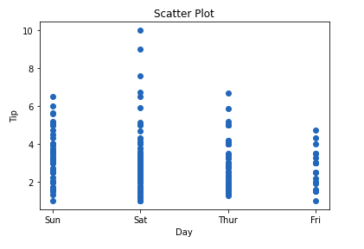
Scatter plot eg:
import pandas as pd
import matplotlib.pyplot as plt
# reading the database
data = pd.read_csv("tips.csv")
# Scatter plot with day against tip
plt.scatter(data['day'], data['tip'])
# Adding Title to the Plot
plt.title("Scatter Plot")
# Setting the X and Y labels
plt.xlabel('Day')
plt.ylabel('Tip')
plt.show()

Slide 9
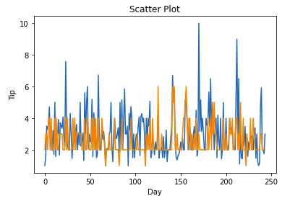
Line Chart
Line Chart is used to represent a relationship between two data X and Y on a different axis. It is plotted using the plot() function.
import pandas as pd
import matplotlib.pyplot as plt
# reading the database
data = pd.read_csv("tips.csv")
# Scatter plot with day against tip
plt.plot(data['tip'])
plt.plot(data['size'])
# Adding Title to the Plot
plt.title("Scatter Plot")
# Setting the X and Y labels
plt.xlabel('Day')
plt.ylabel('Tip')
plt.show()

Slide 10
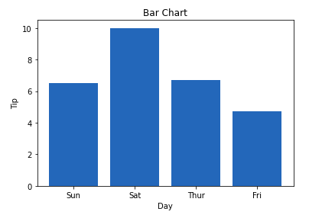
Bar Chart
A bar plot or bar chart is a graph that represents the category of data with rectangular bars with lengths and heights that is proportional to the values which they represent. It can be created using the bar() method.

Slide 11
Histogram
A histogram is basically used to represent data in the form of some groups.
It is a type of bar plot where the X-axis represents the bin ranges while the Y-axis gives information about frequency.
The hist() function is used to compute and create a histogram.
In histogram, if we pass categorical data then it will automatically compute the frequency of that data i.e. how often each value occurred.
A histogram is a diagram involving rectangles whose area is proportional to the frequency of a variable and width is equal to the class interval.

Slide 12
Seaborn
Seaborn is a high-level interface built on top of the Matplotlib. It provides beautiful design styles and color palettes to make more attractive graphs.
To install seaborn type the below command in the terminal.
pip install seaborn

Slide 13
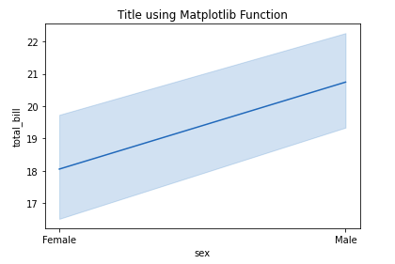
import seaborn as sns
import matplotlib.pyplot as plt
import pandas as pd
# reading the database
data = pd.read_csv("tips.csv")
# draw lineplot
sns.lineplot(x="sex", y="total_bill", data=data)
# setting the title using Matplotlib
plt.title('Title using Matplotlib Function')
plt.show()

Slide 14
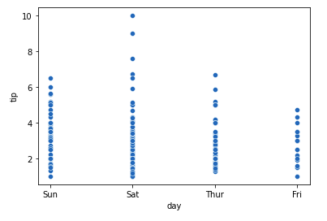
Scatter plot is plotted using the scatterplot() method.
This is similar to Matplotlib, but additional argument data is required.
# importing packages
import seaborn as sns
import matplotlib.pyplot as plt
import pandas as pd
# reading the database
data = pd.read_csv("tips.csv")
sns.scatterplot(x='day', y='tip', data=data,)
plt.show()

Slide 15
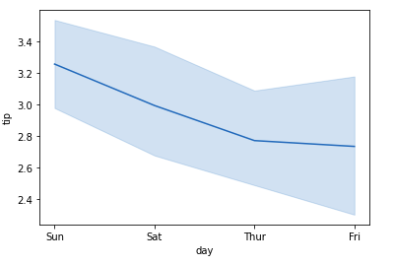
Line Plot
Line Plot in Seaborn plotted using the lineplot() method. In this, we can pass only the data argument also.
# importing packages
import seaborn as sns
import matplotlib.pyplot as plt
import pandas as pd
# reading the database
data = pd.read_csv("tips.csv")
sns.lineplot(x='day', y='tip', data=data)
plt.show()

Slide 16
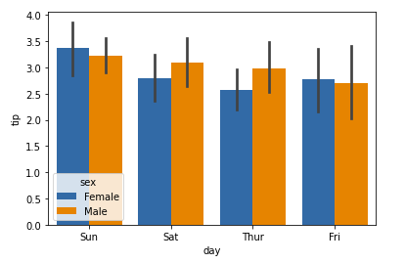
Bar Plot
Bar Plot in Seaborn can be created using the barplot() method.
# importing packages
import seaborn as sns
import matplotlib.pyplot as plt
import pandas as pd
# reading the database
data = pd.read_csv("tips.csv")
sns.barplot(x='day',y='tip', data=data,
hue='sex')
plt.show()

Slide 17
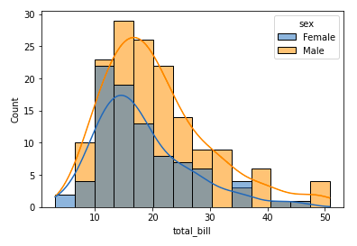
Histogram
The histogram in Seaborn can be plotted using the histplot() function.
# importing packages
import seaborn as sns
import matplotlib.pyplot as plt
import pandas as pd
# reading the database
data = pd.read_csv("tips.csv")
sns.histplot(x='total_bill', data=data, kde=True, hue='sex')
plt.show()

Slide 18
pip install bokeh
Bokeh
The third library is okeh is mainly famous for its interactive charts visualization.
Bokeh renders its plots using HTML and JavaScript that uses modern web browsers for presenting elegant, concise construction of novel graphics with high-level interactivity.
Pip install bokeh
Plotly
The last library plotly.
Potly has hover tool capabilities that allow us to detect any outliers or anomalies in numerous data points.
It allows more customization.
It makes the graph visually more attractive.
To install it type the below command in the terminal.
Pip install plotly

